Slide 1
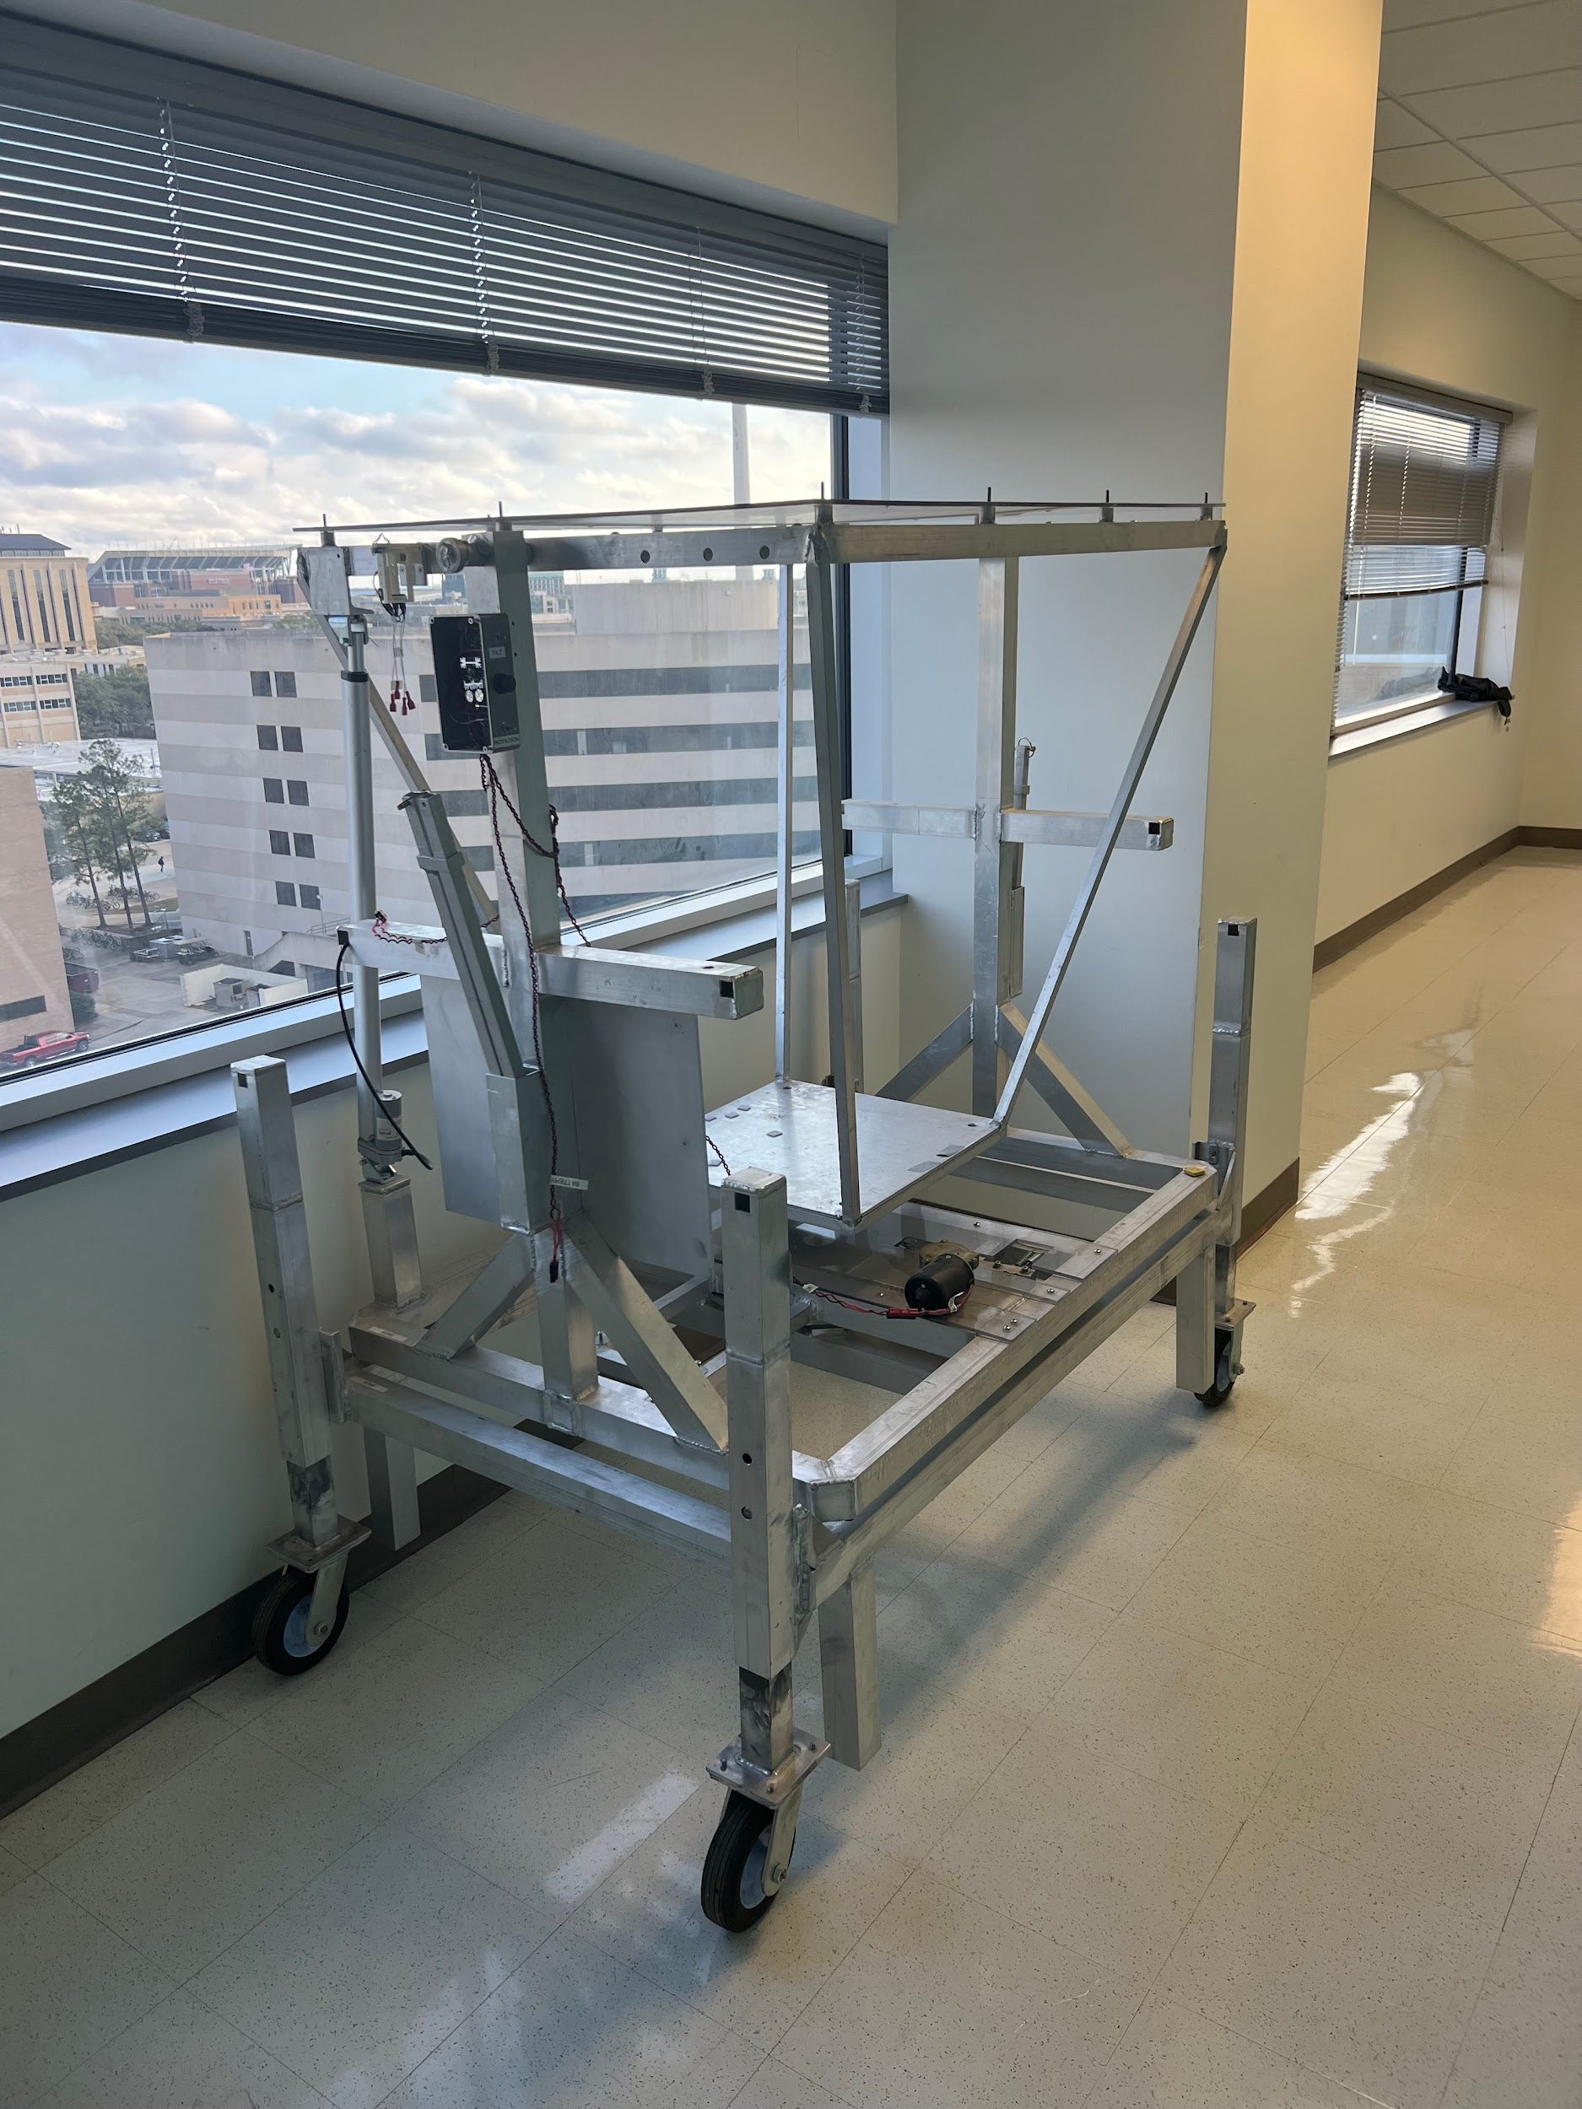

ECEN 404 Update #3 Heliostat Control Tracking Team #66
Jordan George, Samuel Dixon Sponsor: Dr. Madsen
TA: Dalton Cyr

Slide 2
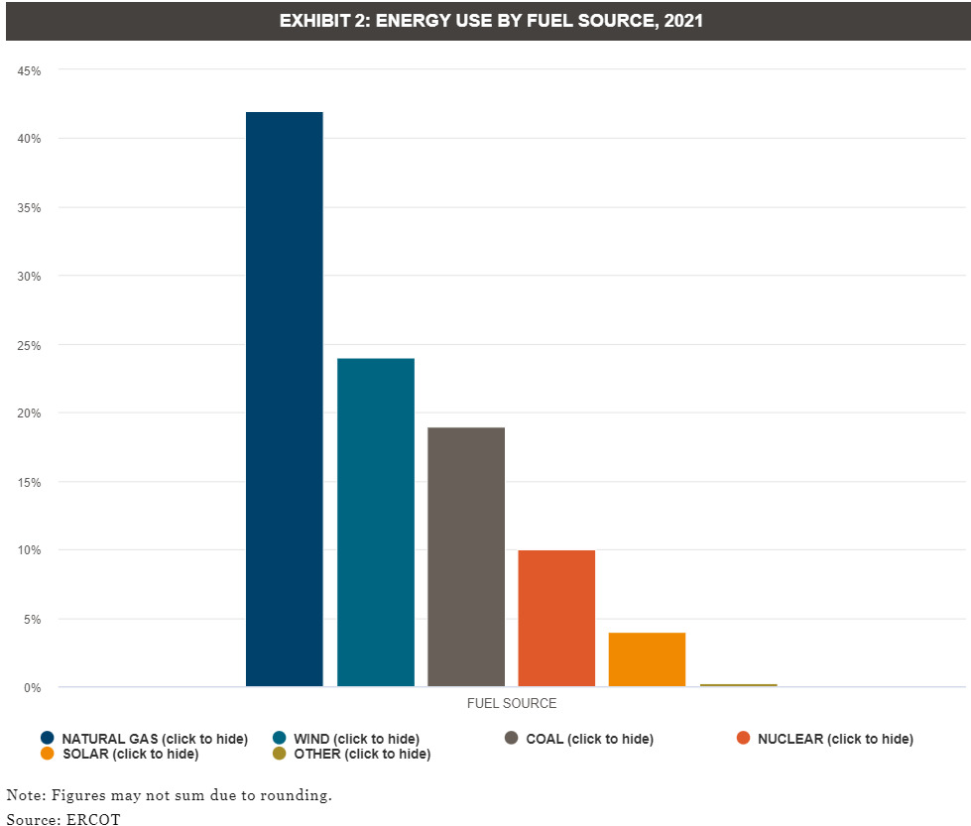
Problem Statement
The world is rapidly changing energy allocation from non-renewable to renewable energy
Done on basis of conscious consumption
Lots of progress in recent years, however solar energy devices still account for little of the total energy

Slide 3
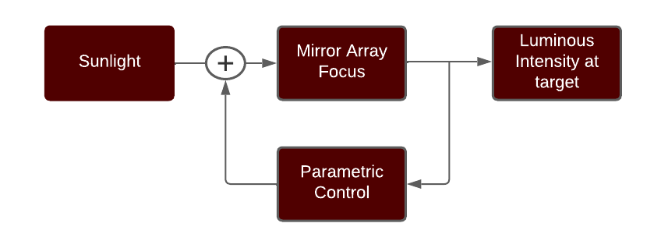
Executive Summary
Track the Sun’s movements with feedback parameters through a Fresnel Lens and focus light onto a target
Notes:
The goal of this research project is to help develop a heliostat for a small-scale solar thermal system consisting of a heliostat to Fresnel lens to target optical path. Currently, heliostat manufacturers design their products for very large CSP systems (concentrating solar power, i.e. power towers) that are not suitable for this R&D project as it would be too cumbersome, costly, possible proprietary issues, and the timeline would be unpredictable.
Problem statement: To demonstrate basic system performance in a timely manner, we will assemble a heliostat and demonstrate solar tracking, through a lens, to a focused target spot with motor control for two axis positioning of the heliostat into a fixed lens/target fixture and incorporate position feedback for closed loop operation. Having a stand-alone heliostat unit that can be easily setup, measured under sun, and returned to the lab for storage is desired. A small battery and possibly a PV panel and controller should be integrated onto the heliostat unit. Wireless control, sensor feedback, possibly a camera on the target area, data acquisition and data logging are desirable using a laptop (MS Windows) and Matlab. The solar input should be measured and an estimate of the solar energy delivered to the target area made (more on this later, we have to measure the direct normal irradiance - ie. DNI - separate from the global horizontal irradiance using a homemade rotating shadowband on an Apogee pyranometer).
Safety is paramount, so starting with a small reflecting area and small lens (eg. around 1 square foot each) will limit the focused beam intensity for initial experiments and aid in the development of safety procedures, control, and hardware to be implemented before focusing larger areas. For larger areas, the focused beam can burn through a metal plate so care must be taken during alignment and tracking as well as the beam "off" process.
Many factors will influence the alignment of the optical path. Alignment errors include misalignments (heliostat and lens/target on separate mounts), motor backlash and motor-induced vibration, and wind.
In the future, we can consider tilting mirrors in the heliostat array for some additional concentration; however, we should start with a planar surface to understand the basic tracking and alignment challenges. Then, we can model the tilt behavior before committing to a more complex hardware implementation.

Slide 4
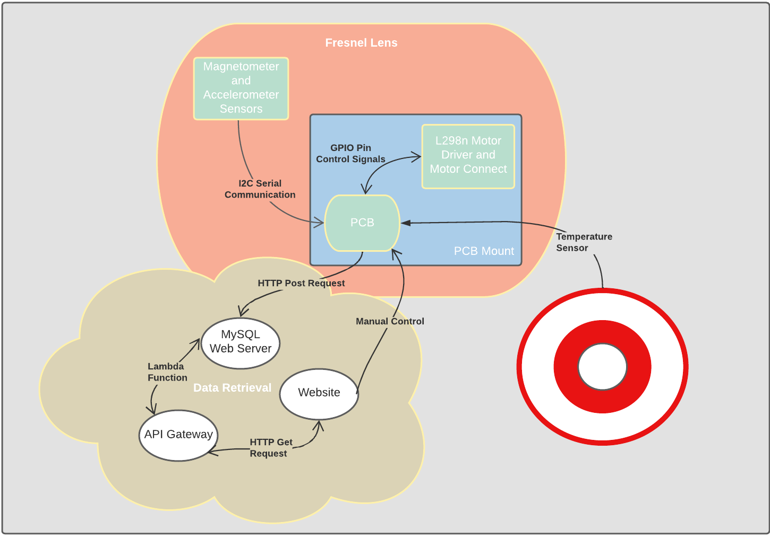
System Overview

Slide 5
System Owners
Jordan
Sam

Slide 6
Project Timeline
1/27/2023
2/20/2023
3/10/2023
4/1/2023
5/2/2023
403 Recovery
Beginning Integration
Final Validation
Demonstration to Sponsor
Subsystem integration
Repartitioning Subsystems, and finalizing individual subsystems
Finishing 403 recovery and testing functionality of I2C serial communication and tracking controls algorithm with motors
Demonstrate microprocessor-based control of rotation and tilt motion to a specific direction of the calculated sun's position, with magnetometer measurement of azimuth and elevation with an accelerometer measurement.
Continue to refine automatic tracking algorithm if needed as well as further debugging to prepare for the final demo.
Full testing and evaluation of performance capability, evaluation of tracking accuracy, full documentation of hardware design, software programming and data pathway for transition to future researcher(s)

Slide 7
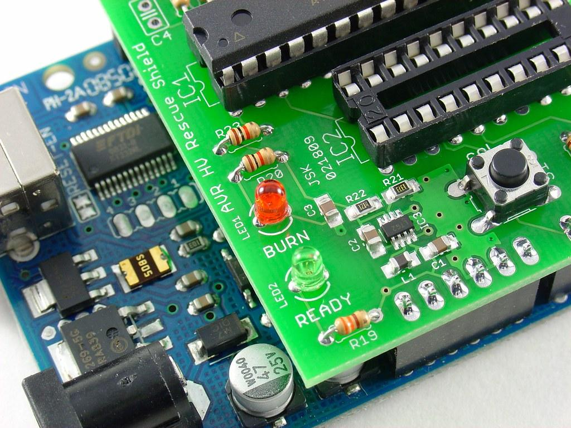

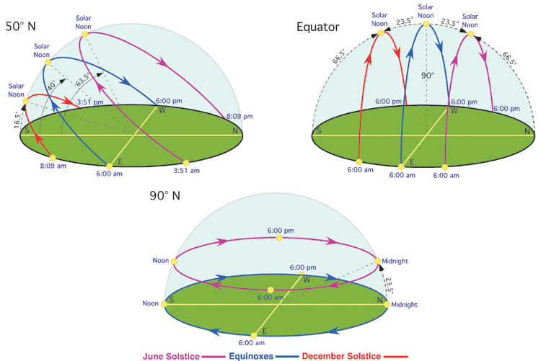
Jordan + Sam
Jordan
Sam
Tracking Control Software
PCB Layout
Data Visualization
Guides the mirror to follow the sun throughout the day
Appropriate angles to reflect the sunlight to the data collection
Physical array to hold the mirrors in a parabolic shape
Organizing circuit block level components and interfacing these with ESP32 WROOM Microprocessor
Doing layout of components in orderly fashion
Providing real time data analytics and insights for system feedback and functionality
Human machine interface for interacting with the motors

Slide 8
Recovery for Motor Control Tracking
Tracking Control: (Jordan George)
Finalize tracking control algorithm to allow the motors to rotate and tilt based on the sun’s location
Using ESP32 on PCB to communicate with L298n motor driver
Sensors: (Samuel Dixon)
Configure I2C bus serial communication with sensors
Send data to AWS RDS (MySQL Web Server) via post request

Slide 9
Jordan + Sam
Jordan
Sam
Tracking Control Software
PCB Layout
Data Visualization
Guides the mirror to follow the sun throughout the day
Appropriate angles to reflect the sunlight to the data collection
Physical array to hold the mirrors in a parabolic shape
Organizing circuit block level components and interfacing these with ESP32 WROOM Microprocessor
Doing layout of components in orderly fashion
Providing real time data analytics and insights for system feedback and functionality
Human machine interface for interacting with the motors

Slide 10
PCB & Tracking Control Subsystem
Jordan George
Completed in the last 2 weeks Hours of Effort: 29 hours | Ongoing progress and goals for next 2 weeks
Found a solution for getting the current time and date stamp Flash and monitored code onto PCB (Hello world code, LED blink code, and Solar angle calculation code) Ordered next iteration of PCB (added more header pins for sensors and motor driver) | Solder on all components once the new iteration of PCB gets here (scheduled for this Thursday) Continue to work on motor positioning algorithm

Slide 11
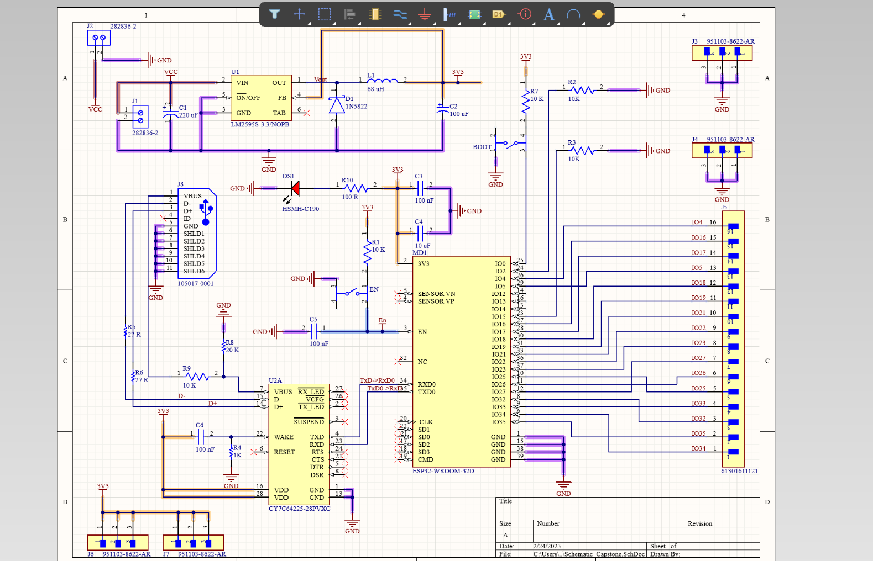
PCB Layout

Slide 12
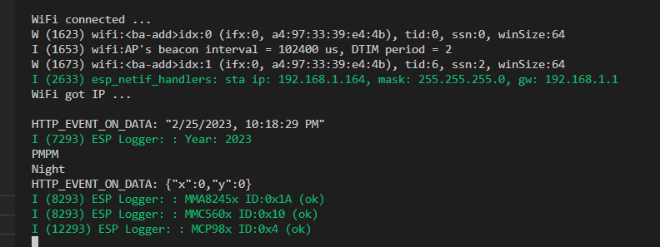
Tracking Control Subsystem
Solution to get current date and time from HTTP request from web app

Slide 13
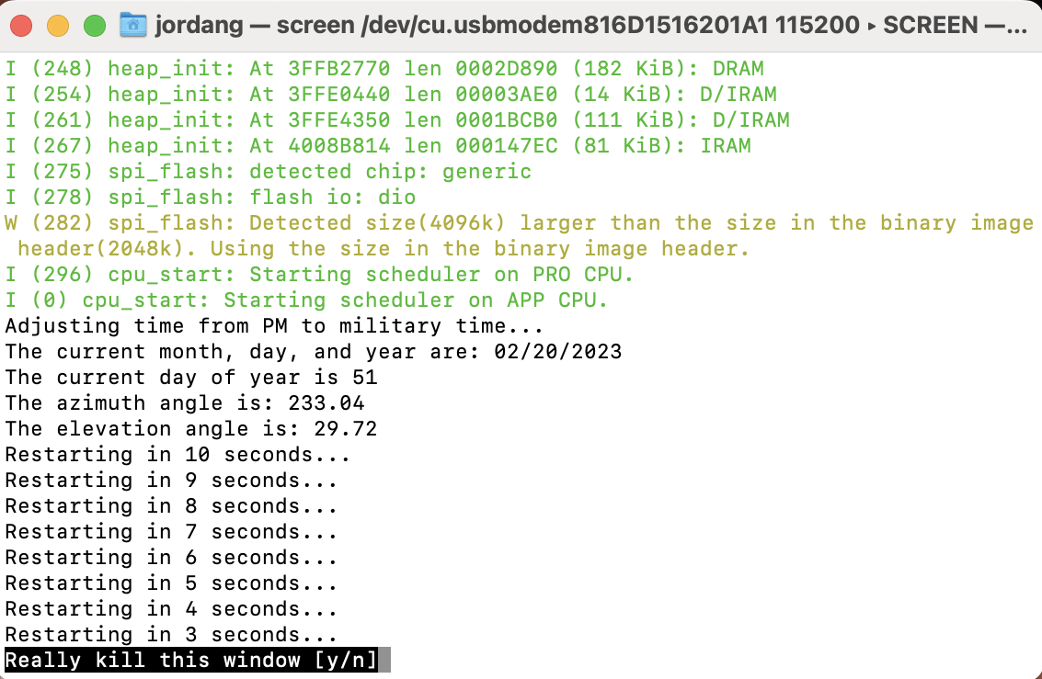
Tracking Control Subsystem
Flashed solar angle calculations on the PCB

Slide 14
Jordan + Sam
Jordan
Sam
Tracking Control Software
PCB Layout
Data Visualization
Guides the mirror to follow the sun throughout the day
Appropriate angles to reflect the sunlight to the data collection
Physical array to hold the mirrors in a parabolic shape
Organizing circuit block level components and interfacing these with ESP32 WROOM Microprocessor
Doing layout of components in orderly fashion
Providing real time data analytics and insights for system feedback and functionality
Human machine interface for interacting with the motors

Slide 15
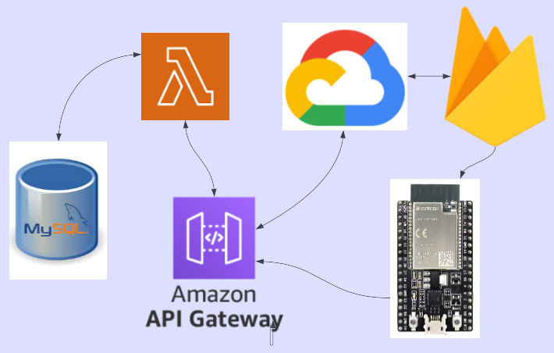
Data Visualization Subsystem

Slide 16
Data Visualization and I2C Sensor Subsystem
Samuel Dixon
Completed in the last 2 weeks Hours of Effort: 20 | Ongoing progress and goals for next 2 weeks
Confirmed both devices and communication capabilities on I2C bus Sensor sweep for accelerometer and temperature Updated Front-End of website with improved selectivity and included three more graphs ( for comparison of metrics ) | Update backend with frontend changes Resolve Magnetometer issues Post request from sensor routine from ESP32 to MySQL AWS Web server

Slide 17
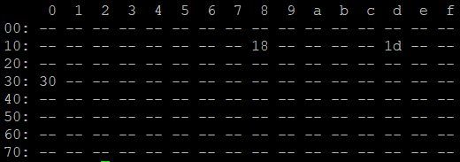
I2C Confirmation via I2C Tool in ESP-IDF
0x18 = MCP9808 Temperature
0x30 = MMC5603NJ Triple Axis Accelerometer
0x1d = MMA8451Q Triple Axis Accelerometer

Slide 18
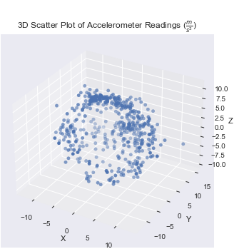
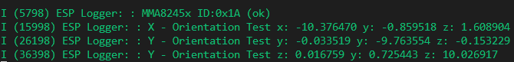
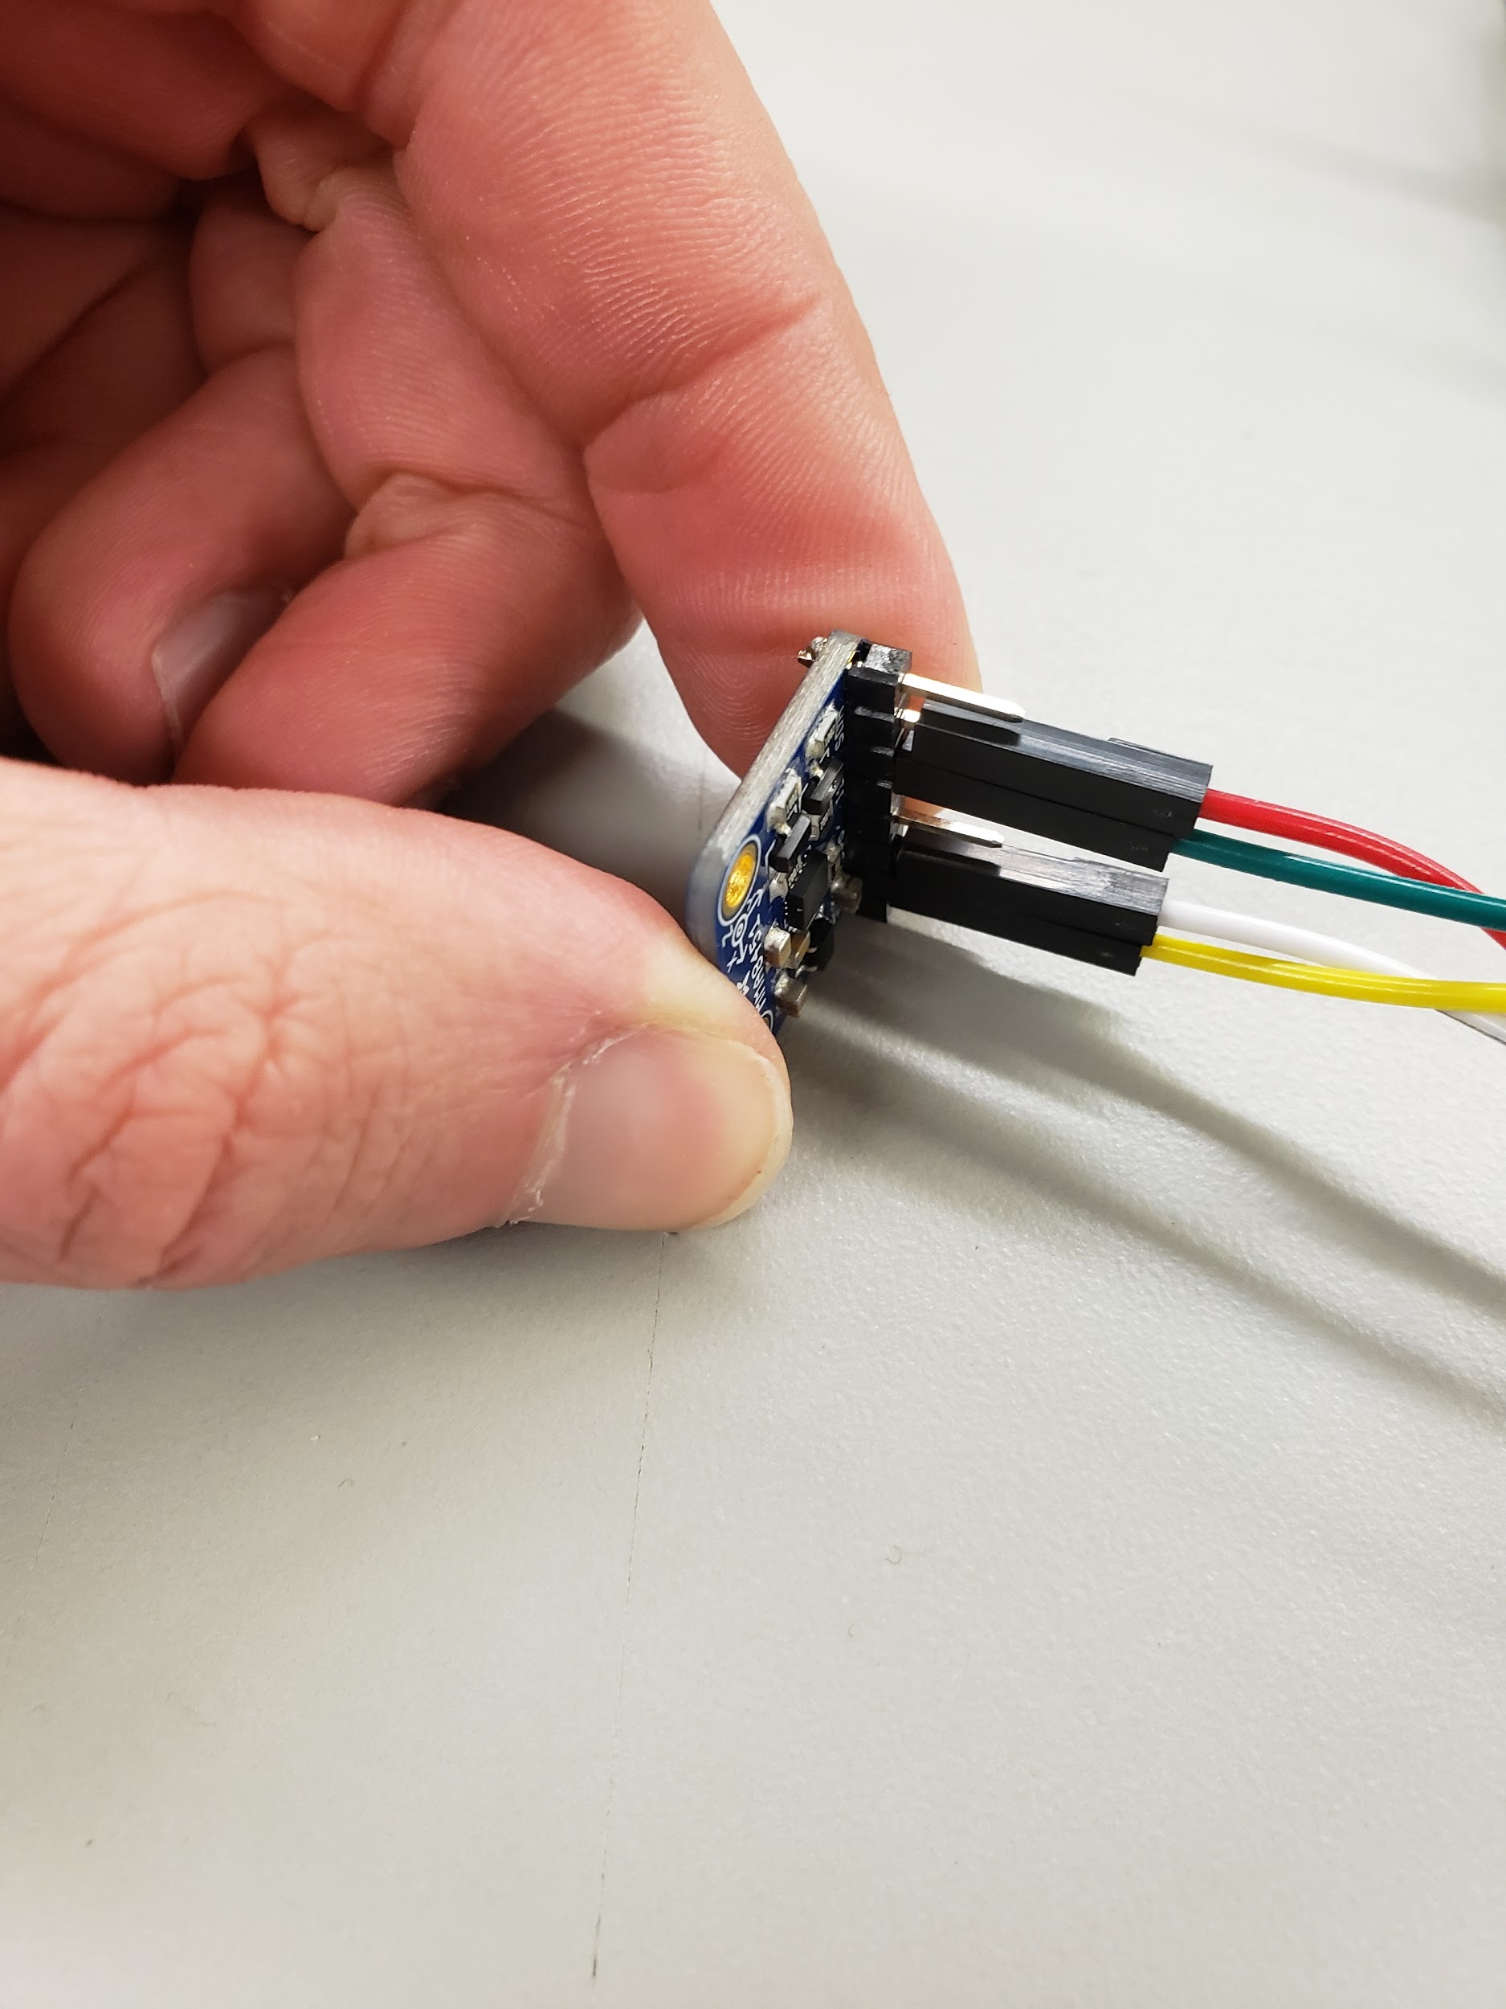
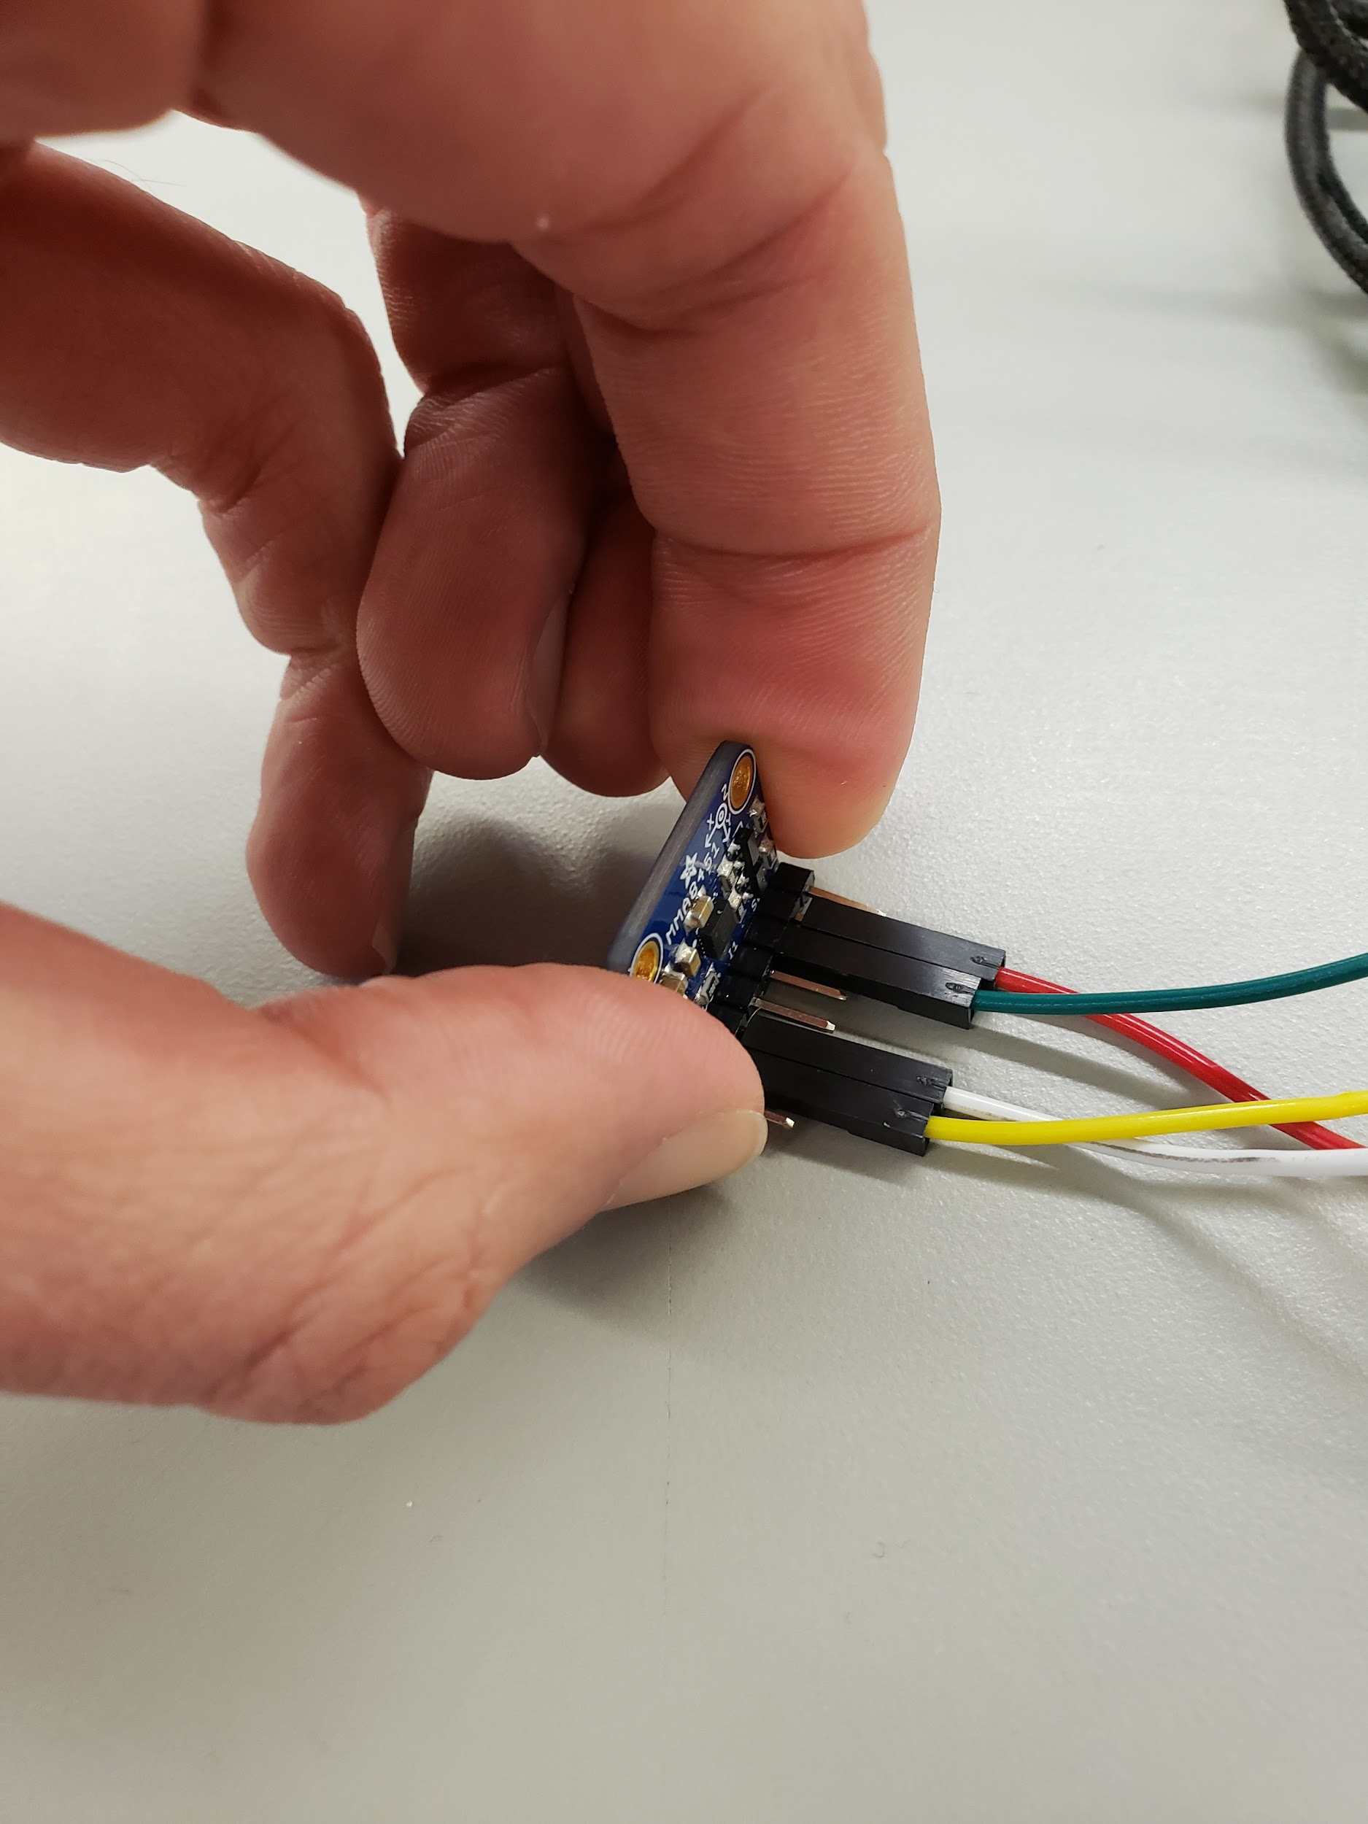
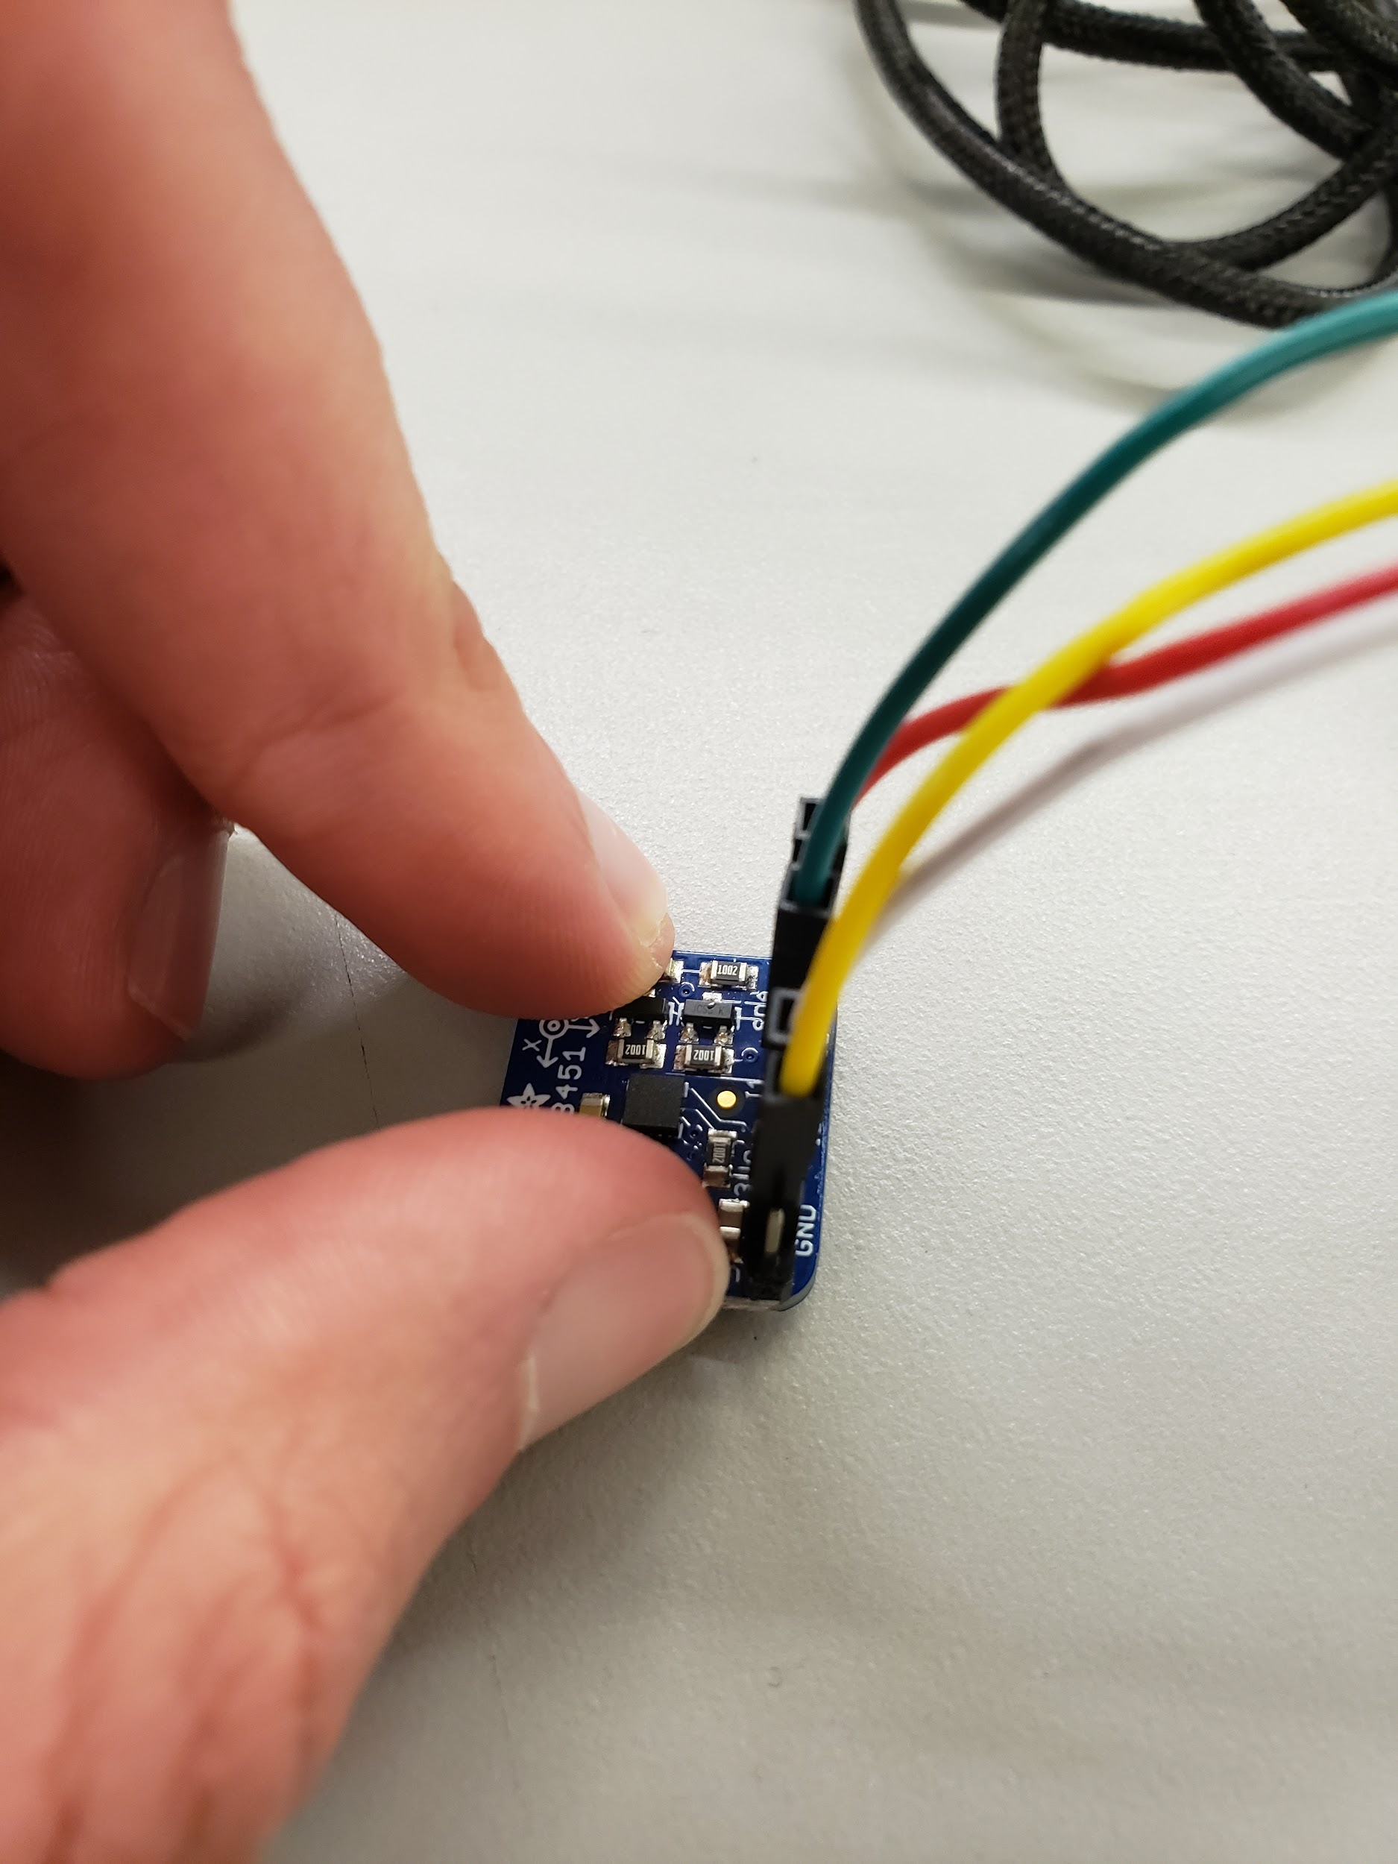
Orientation Tests and 3-D Sweep
X
Y
Z

Slide 19
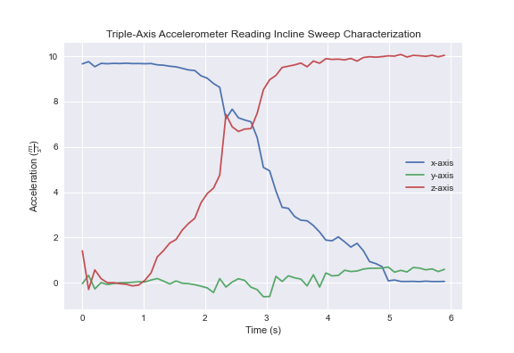
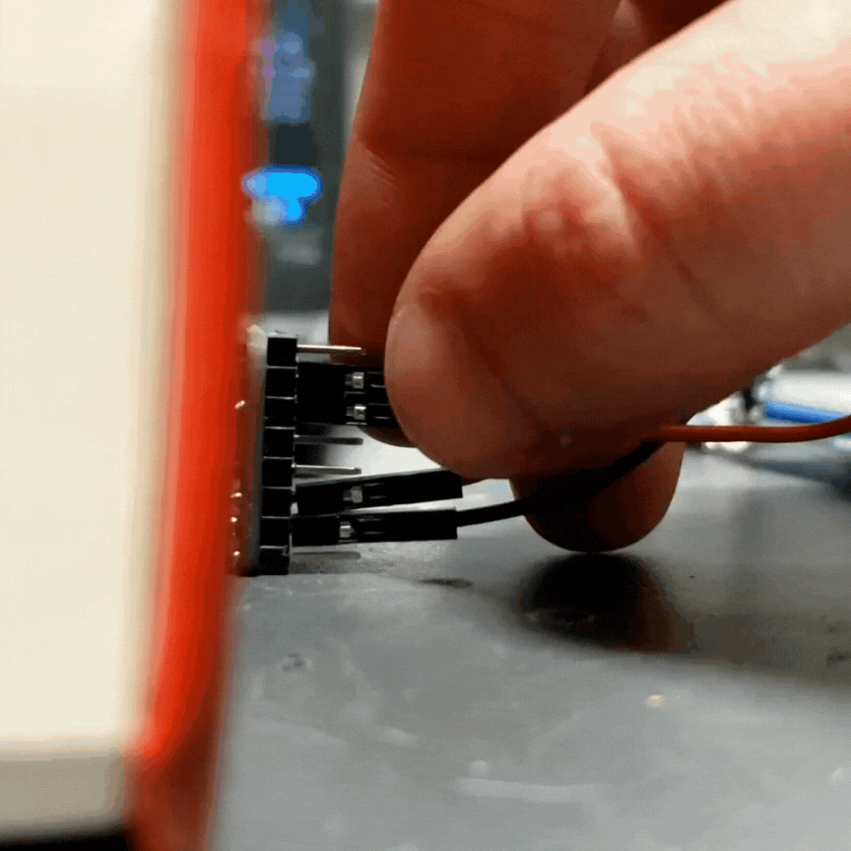
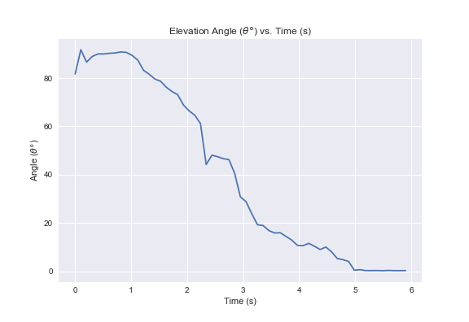
Accelerometer Testing
Vector Decomposition:
x gets all of gravitational force at 90 degree
y gets all of gravitational force at 0 degree
Angles in reference from Horizontal

Slide 20
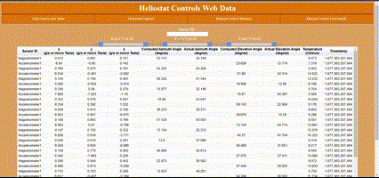
Front End Web Application Updates

Slide 21
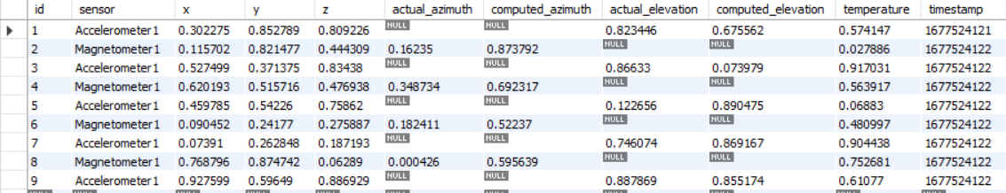
Back End Update
Reorganized database to reflect front-end of website changes
Working on Updating Lambda Script to send data with API Gateway

Slide 22
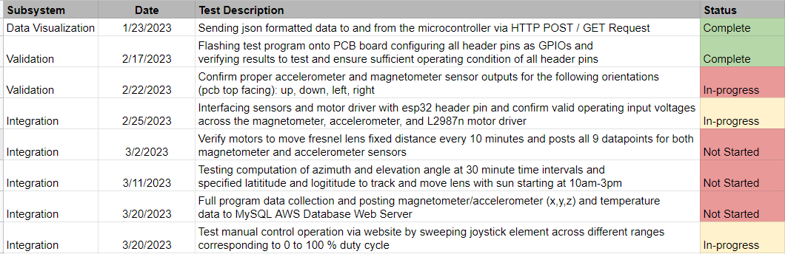
Validation Plan

Slide 23
Q&A
Thank you for listening to the Heliostat Control Tracking Presentation

